Slide 1

Lecture 9
Software Design and Architecture
Rana Taimur Khan
Lecturer GCUF

Slide 2
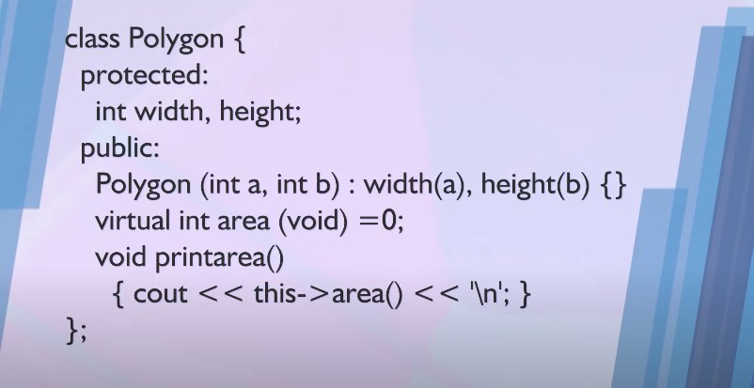
Object Oriented programming Inheritance and Polymorphism
Example:

Slide 3
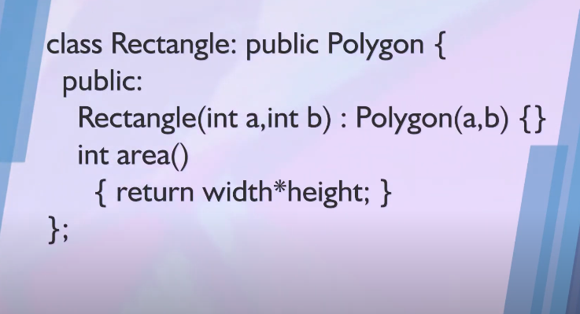
Object Oriented programming Inheritance and Polymorphism
Example:

Slide 4
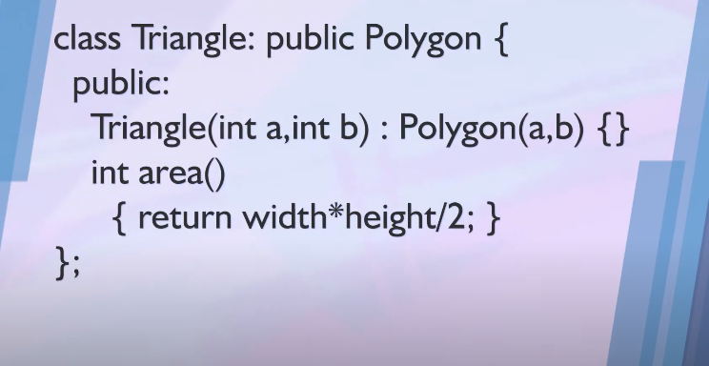
Object Oriented programming Inheritance and Polymorphism
Example:

Slide 5
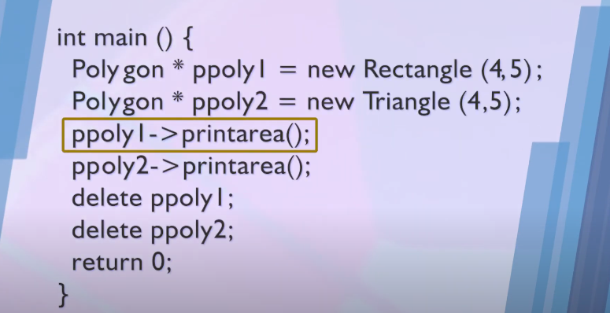
Object Oriented programming Inheritance and Polymorphism
Example:

Slide 6
Object Oriented programming Inheritance and Polymorphism
Question:
What do we gain by using the base class in the declaration?
Polygon * ppolyI = new Rectangle (4,5);
Polygon * ppoly2 = new Triangle (4,5);
Why not
Rectangle * ppolyI = new Rectangle (4,5);
Triangle * ppoly2 = new Triangle (4,5);

Slide 7
Object Oriented programming Inheritance and Polymorphism
int main(){
Polygon * ppoly[10];
ppoly[0] = new Rectangle (4,5);
ppoly[I] = new Triangle (4,5);
// and so on
for (int i=0; i<10; i++)
ppoly[i]->printarea();
//rest of the code
return 0;
}

Slide 8
Object Oriented programming Object Creation and Factory method
int main(){
Polygon * ppoly[10];
ppoly[0] = new Rectangle (4,5);
ppoly[I] = new Triangle (4,5);
// and so on
for (int i=0; i<10; i++)
ppoly[i]->printarea();
//rest of the code
return 0;
}
Object Creation is not Polymorphic

Slide 9
Object Oriented programming Object Creation and Factory method
Factory method:
Polygon * createPolygon(char t, int w, int h){
if (t==‘R’)
return new Rectangle(w,h);
else if (t==‘T’)
return new Triangle(w,h);
}
Object Creation and factory Method

Slide 10
Object Oriented programming Object Creation and Factory method
int main(){
Polygon * ppoly[10];
for (int i=0; i<10; i++) {
//get type, width and height of the object
//to be craeted
ppoly[i] = createPolygon(t,w,h);
//pseudo polymorphic behaviour
}
for (int i=0; i<10; i++)
ppoly[i]->printarea();
//rest of the code
return 0;
}

Slide 11
Object Oriented programming The Magic Behind polymorphism
What does a Compiler Do?
Compiler maintains two things:
vtable: A table of function pointers. It is maintained per class.
vptr: A pointer to table. It is maintained per object.

Slide 12
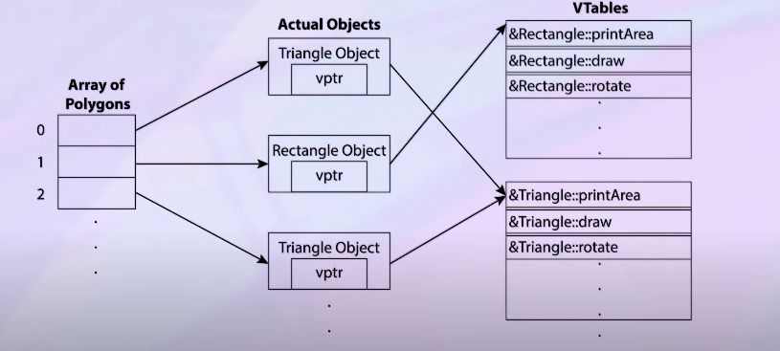
Object Oriented programming The Magic Behind polymorphism

Slide 13
Object Oriented programming The Magic Behind polymorphism
Compiler adds code at two places to maintain and use vptr.
Code in every constructor. This code sets vptr of the object being created.
Code with polymorphic function call.
Whenever a polymorphic call is made, compiler inserts code to first look for vptr.
Once vptr is fetched, vtable of derived class can be accessed. Using vtable, address of derived class.

